Slide 1
Contactors & Relays

Slide 2
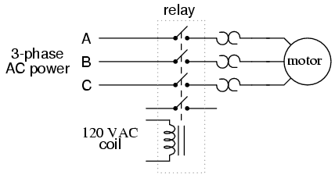
Contactors
Contactors are relays that switch high current loads a.k.a magnetic starters

Slide 3
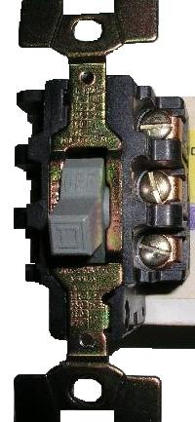
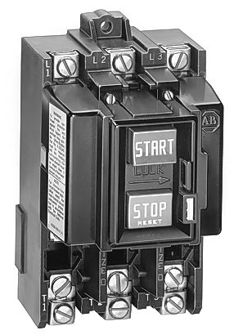
Manual Motor Starter

Slide 4
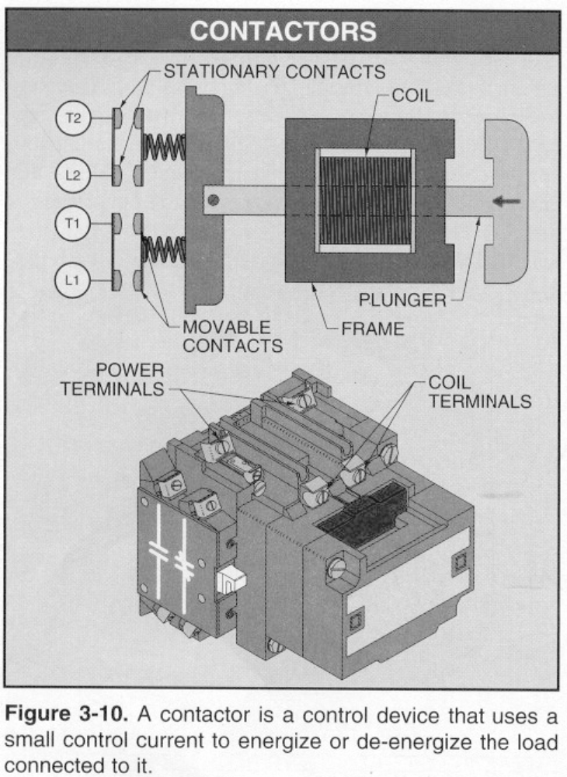
Contactors
A Contactor is a control device that uses a small control current to energize or de-energize the load connected to it.
Abouts:
A contactor has a frame, plunger, and a solenoid coil.
The action of the plunger is used to close (or open) sets of contacts.
A contactor does not include overload protection.
The closing of the contacts allows electrical devices to be controlled from remote locations.
Notes:
Electric Motor Controls, G. Rockis, 2001

Slide 5
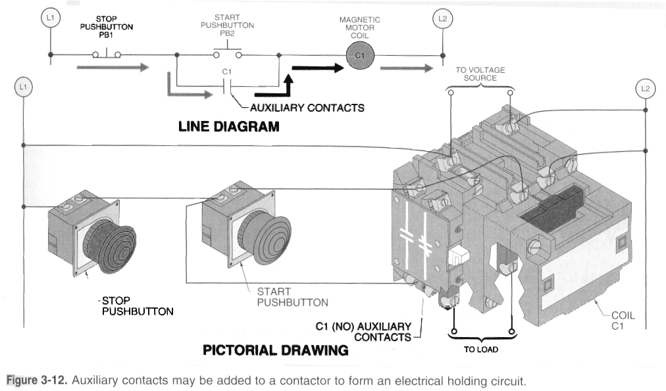
Example of a Wired Contactor

Slide 6
Magnetic Motor Starters
A magnetic motor starter is an electrically-operated switch (contactor) that includes motor overload protection.
Magnetic motor starters are identical to contactors except that they have overloads attached to them.
The overloads have heaters or electronic overloads (located in the power circuit) which sense excessive current flow to the motor.
The heaters open the NC overload contacts (located in the control circuit) when the overload becomes dangerous to the motor.

Slide 7
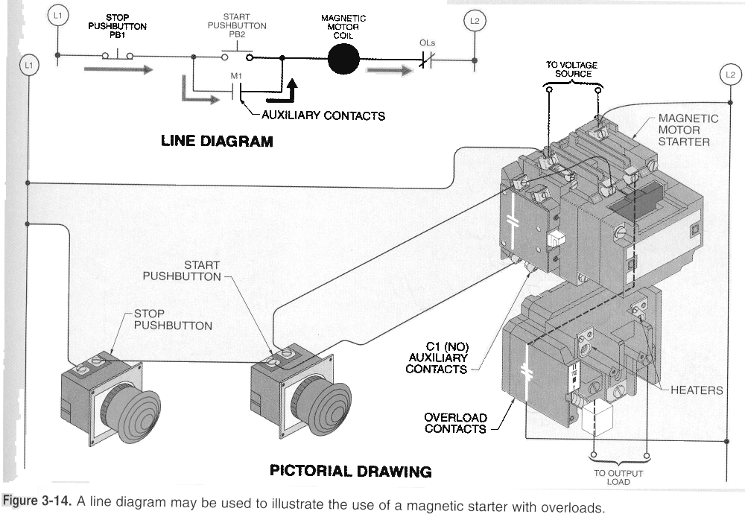
Magnetic Starter

Slide 8
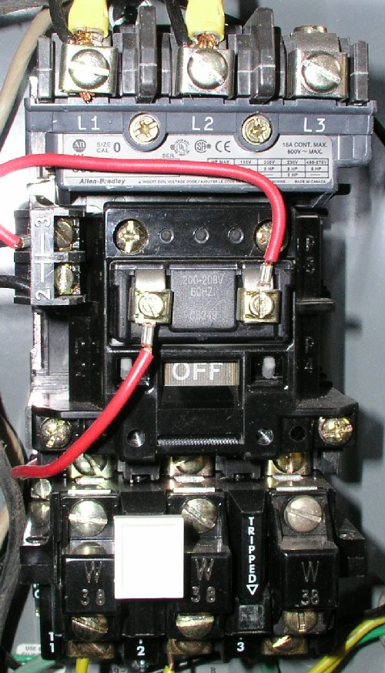
Magnetic Motor Starter
L1 (1) - first line in from power source (phase 1 for 3ph / Neutral for 1ph)
L2 (3) - second line in from power source (phase 2 for 3ph / Hot for 1ph* see below for alternate wiring using L2 & L3)
L3 (5) - third line in from power source (phase 3 for 3ph / NC for for 1ph)
COIL
T1 (2) - first line out to motor (phase 1 for 3ph / Hot for 1ph)
T2 (4) - second line out to motor (phase 2 for 3ph / NC for 1ph* see below for alternate wiring)
T3 (6) - third line out to motor (phase 3 for 3ph / Neutral for 1ph)

Slide 9
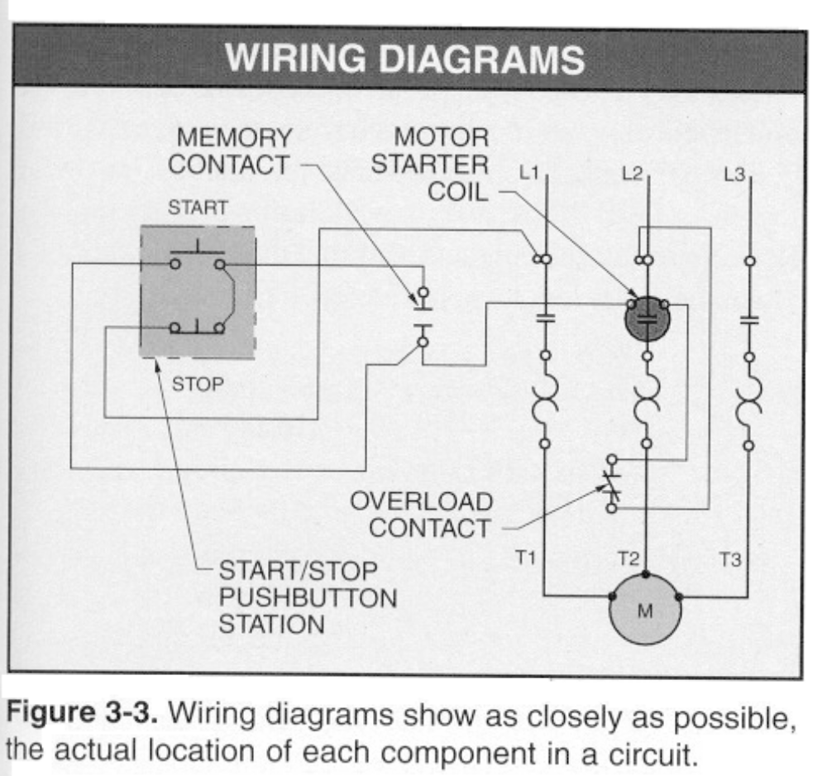
Motor Starter Control Circuit
Alternate method of drawing the electrical circuit

Slide 10
NEMA vs IEC
If we compare the NEMA magnetic motor starter to the IEC magnetic motor starter, the following differences would be noticed:
An IEC device is physically smaller than a comparable NEMA device.
An IEC device is usually less expensive than a comparable NEMA device.
An IEC device has a life cycle of approximately one million operations while a comparable NEMA device has a life cycle of almost four times that number.
An IEC device should normally be protected with fast-acting, current-limiting fuses while a NEMA device can be protected with conventional time delay fuses.

Slide 11
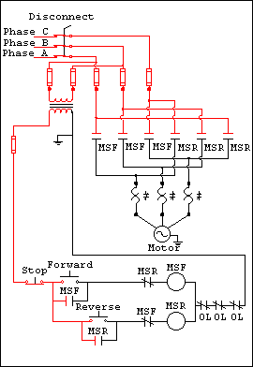
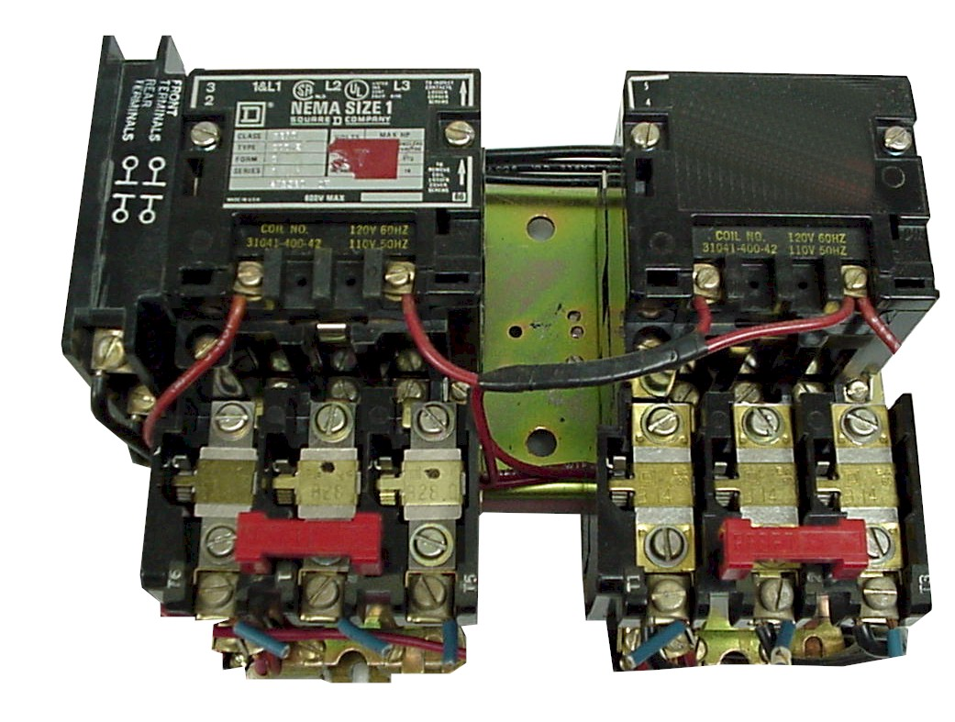
Reversing Starter

Slide 12
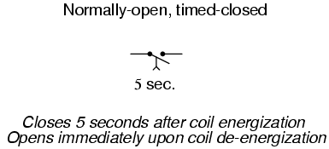
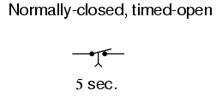
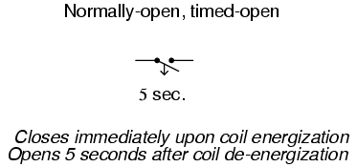
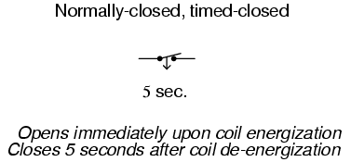
Relay Timers
ON Delay
OFF Delay

Slide 13
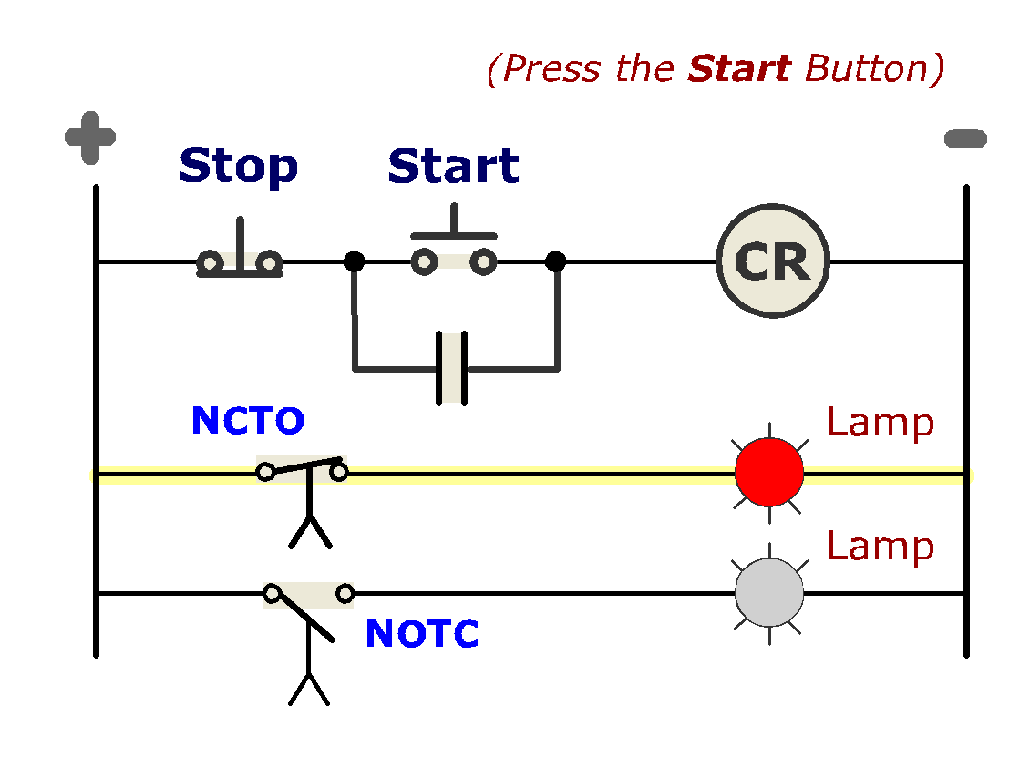
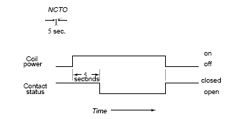
Wired ON Delay
X1
OFF
X2
Energy applied to power rails
NO
ON
NC
1

Slide 14
Wired ON Delay - NCTO
X1
ON
X2
Energy applied to power rails
Start PB is pressed
  - Coil is energized
  - Holding contact close
  - Timer contact stays closed, lamp stays on.
  - Count begins (5 sec)
NC
ON
NC
2

Slide 15
Wired ON Delay - NCTO
X1
ON
X2
3. Timer count ends
  - Coil is still energized
  - Timer contact open
  - lamp goes off.
4. Timer contacts remain open until the coil is de-energized
NC
OFF
NO
3
The Normally Closed contact will take 5 seconds To Open when the coil is energized.

Slide 16
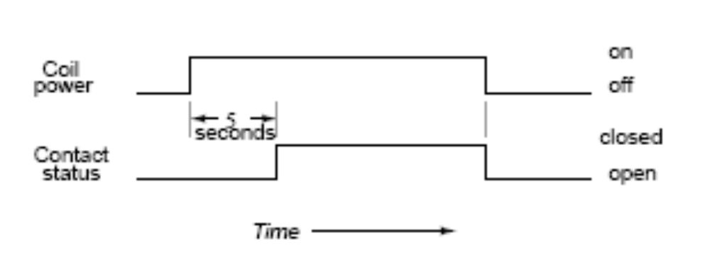
ON Delay - NOTC
X1
OFF
X2
Power is applied to rails
NO
OFF
1
The Normally Open contact will take 5 seconds To Close when the coil is energized.

Slide 17
ON Delay - NOTC
X1
ON
X2
Start PB is pressed
  Coil energizes
  Holding contacts close
  Timer contacts stay open
  Lamp stays off
  Counter starts to count (5 sec)
NC
OFF
2
The Normally Open contact will take 5 seconds To Close when the coil is energized.

Slide 18
ON Delay - NOTC
X1
ON
X2
3. Counter finishes count
  Coil stays energized
  Timer contacts close
  Lamp goes on
4. Timer contacts will open when relay coil is de-energized.
NC
NC
ON
3
The Normally Open contact will take 5 seconds To Close when the coil is energized.

Slide 19
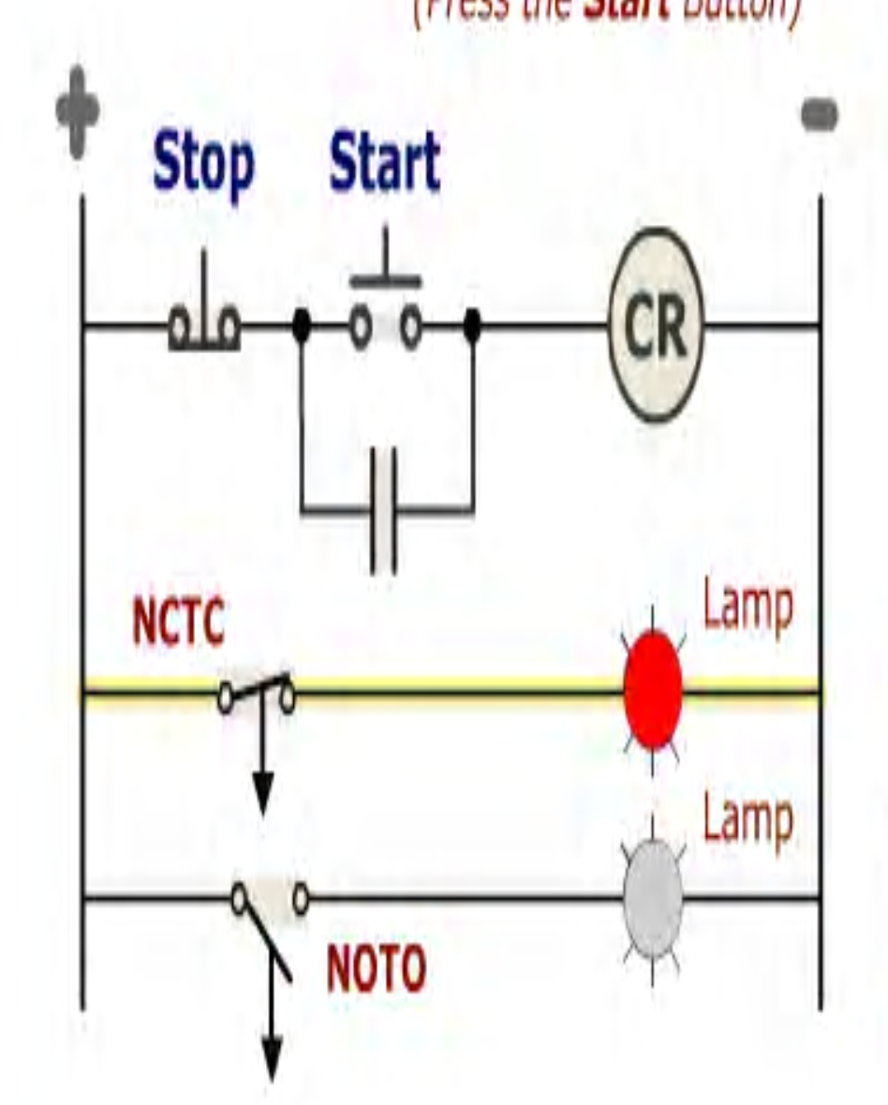
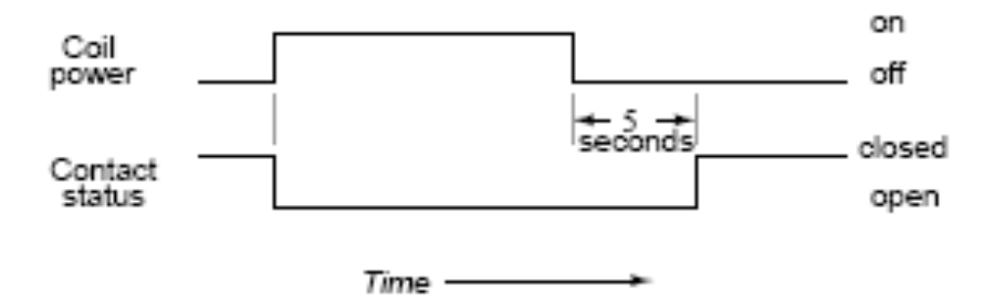
OFF Delay - NCTC
Power is applied to rails
Coil is off, contacts are closed, lamp is on
The timer contacts will close 5 seconds after the coil is de-energized

Slide 20
OFF Delay - NCTC
Start PB is pressed
Timer contacts open
Counter will start to count only when coil is de-energized.

Slide 21
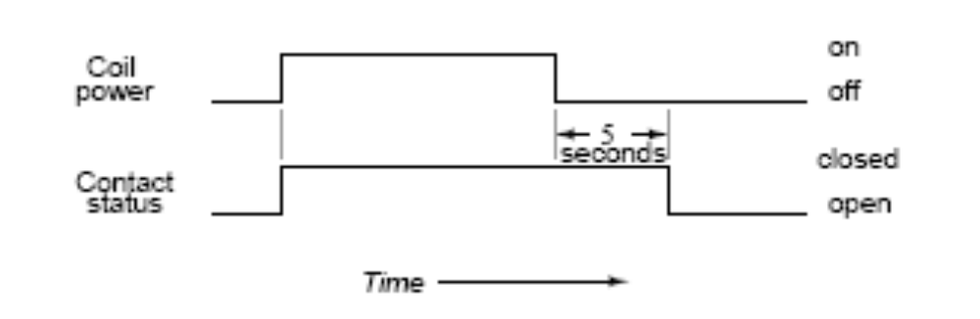
OFF Delay - NOTO
Power is applied to rails
Coil is off, contacts are closed, lamp is on

Slide 22
OFF Delay - NOTO
Start is pressed.
Contacts close, lamp on
Counter only starts when coil is de-energize

